Slide 1
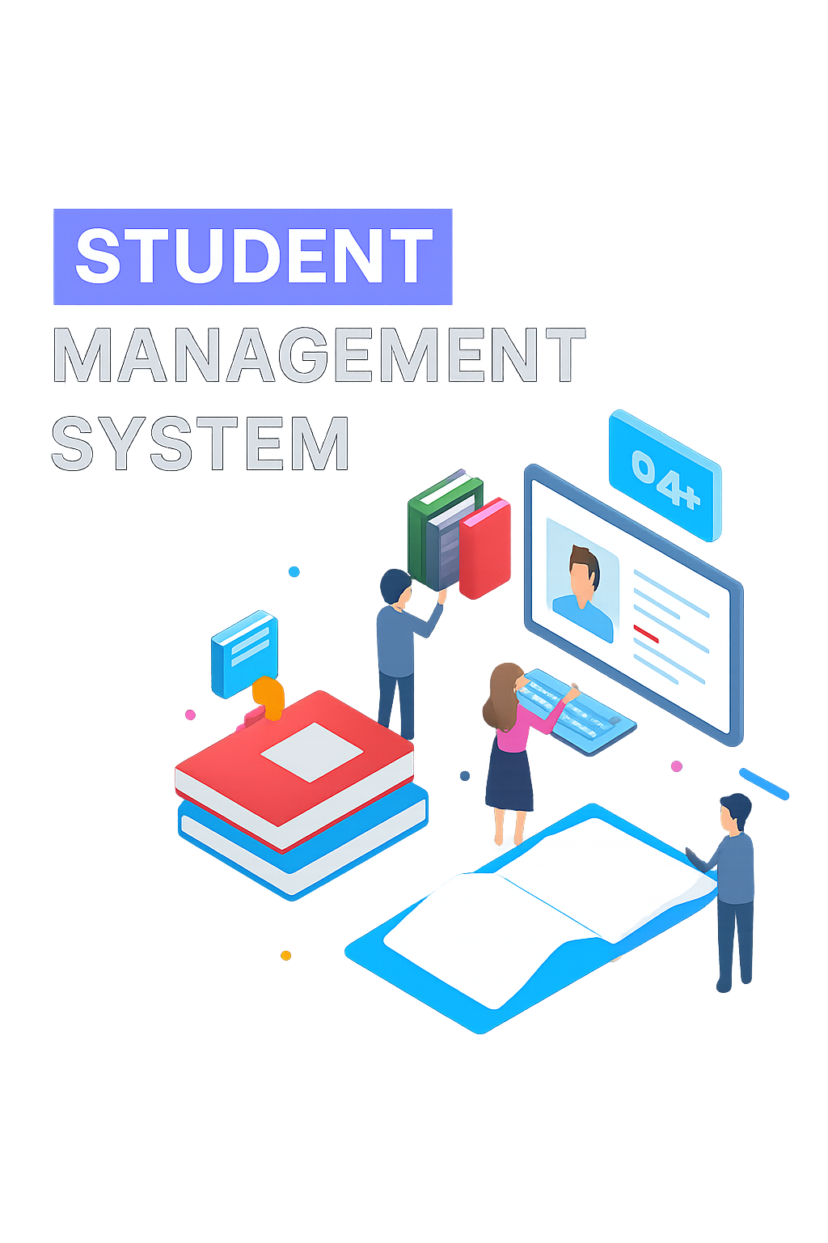

Mohamed Sikkandar M
Java Full Stack Course

Slide 2
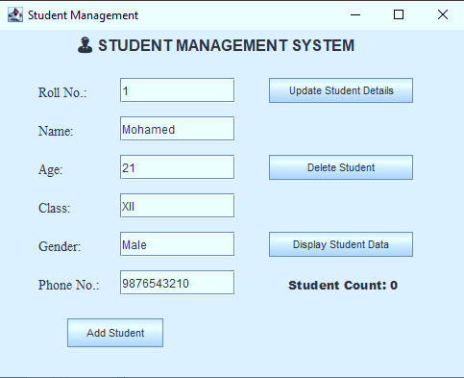
Introduction of Project
The Student Management System is a desktop-based application designed to manage student details such as name, age, class, and contact number efficiently.
The system allows easy addition, updating, deletion, and viewing of student records through a graphical interface..

Slide 3

Why Choosing This Project?
Manual record management is time-consuming and error-prone.
Most institutions need an easy way to update or retrieve student details.
I chose this project to apply Java, JDBC, and GUI knowledge practically to solve a real-world problem.

Slide 4
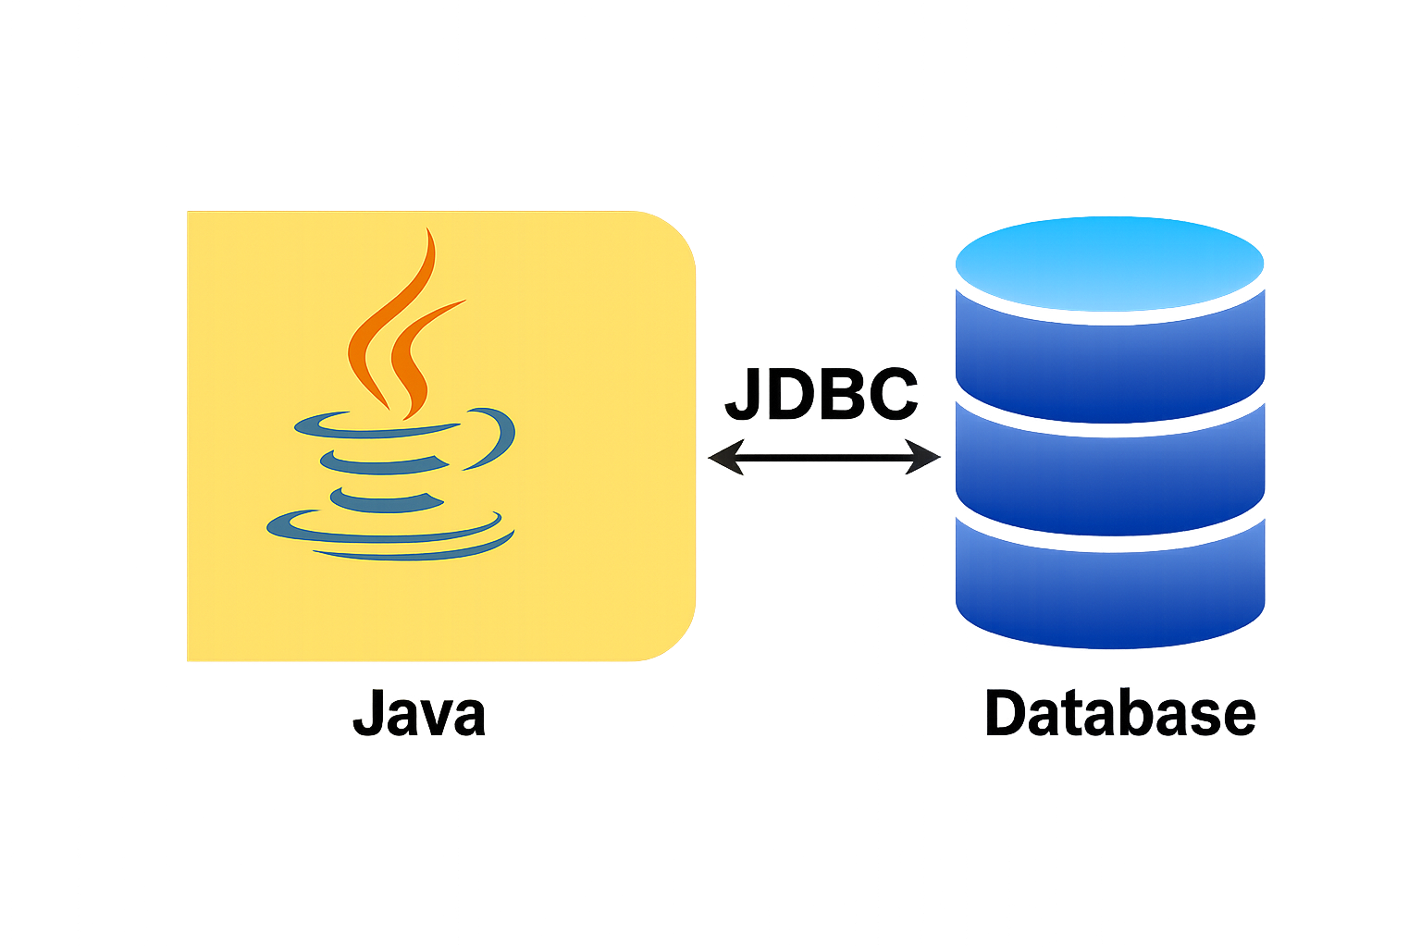
Technology Used
Java Swing (for GUI Design)
JDBC (for Database Connectivity)
MySQL (for storing student data)
Eclipse IDE

Slide 5

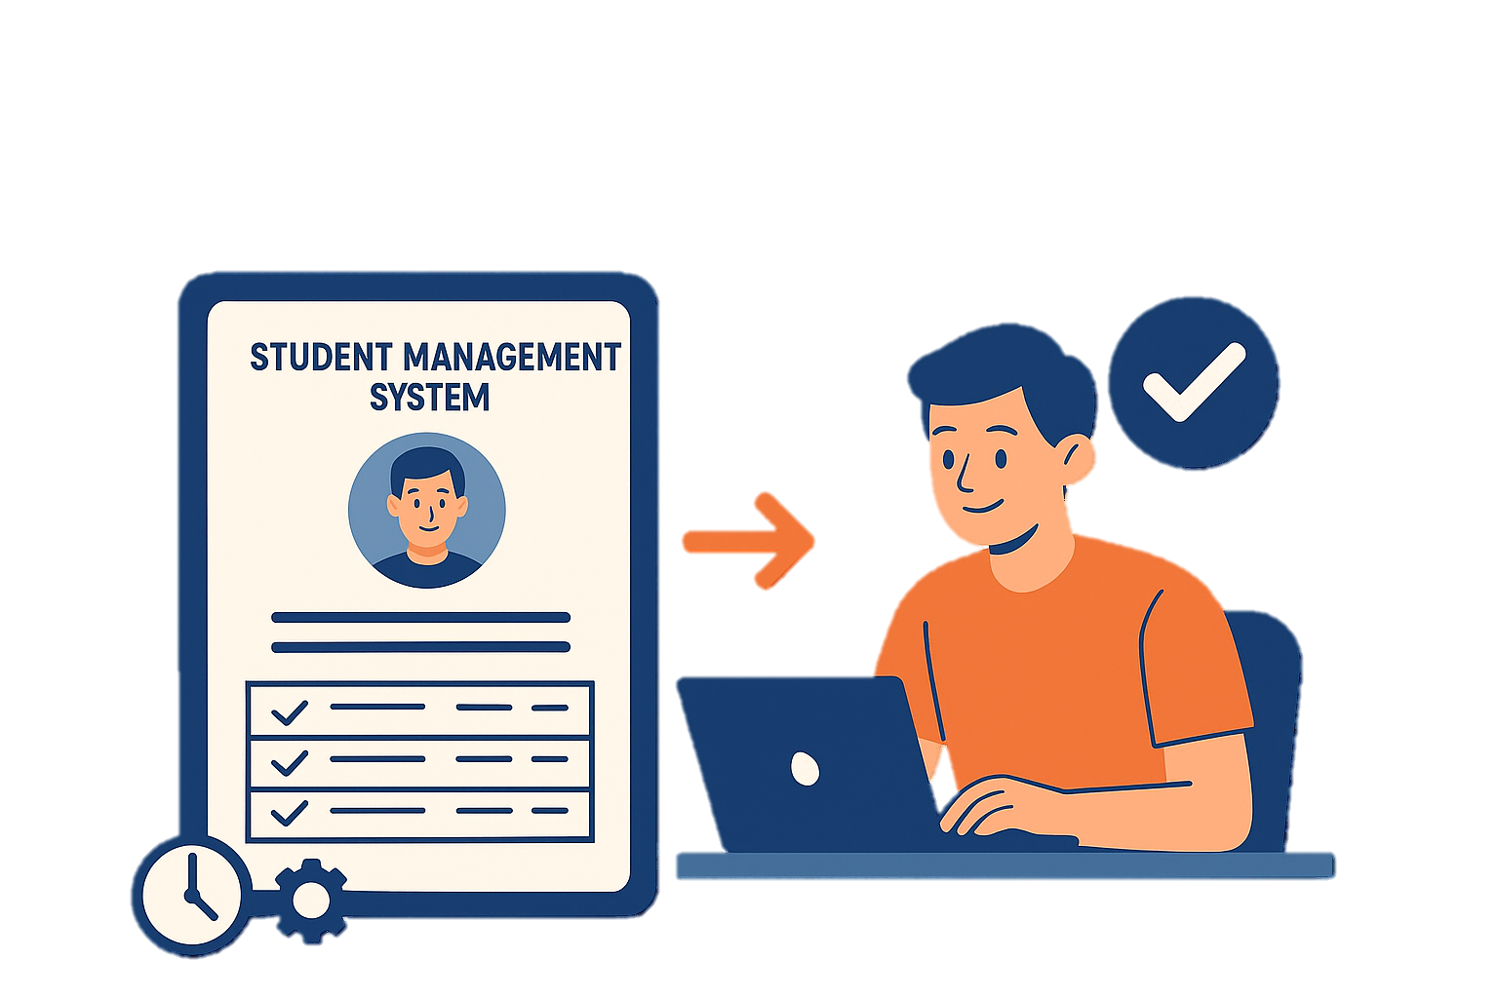
Advantages
Easy record management
Reduces manual work
Accurate and fast updates
Secure data handling

Slide 6
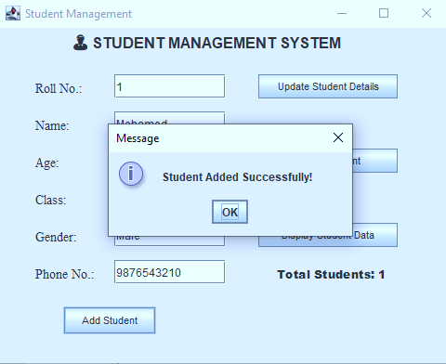
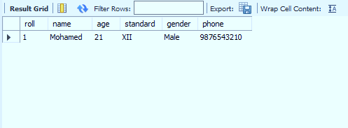
Output Screenshot

Slide 7
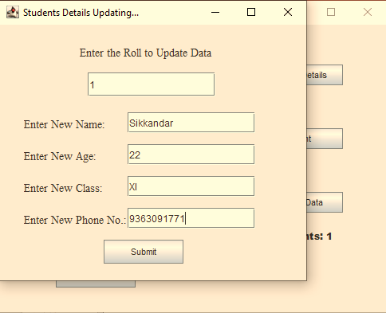
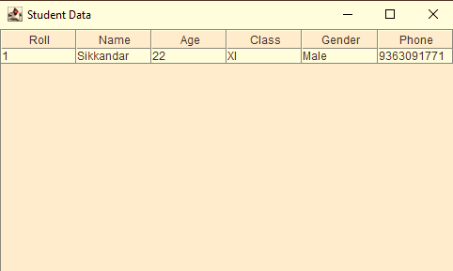
Output Screenshot

Slide 8
Conclusion
The Student Management System helps educational institutions maintain student data efficiently and accurately. Future improvements can include:
Search functionality
Login authentication
Integration with cloud database

Slide 9
Thank You
Presented by: Mohamed Sikkandar M Project: Student Management System Institute: INNOVEL Training Institute, Madurai

